Slide 1
Finding Promising Locations using Facebook Data Analytics
Mid-Term Evaluation
Supervisor: Prof. J.K. Jha
By Ashutosh Yadav (13IM30022)

Slide 2
INTRODUCTION
Location is a crucial factor of retail success as 94% of retail sales are still transacted in physical stores.
It is important assess the potential success values of property locations so as to determine the appropriate business to lease the property to and for the right amount.
Choosing an optimal physical location is a critical decision for business as many factors contribute to the final choice of the location.

Slide 3
OBJECTIVE
Use data collected through Facebook to answer the following questions:
Where should an owner set up his physical store so as to optimize store’s popularity?
What are the important factors influencing a store’s popularity?
Given a target location where a business is to be setup, extract relevant data of businesses within the vicinity of the target location and use them to estimate the popularity of the target location?

Slide 4
METHODOLOGY
Data Harvesting:
Collect data about store locations and number of Check-ins and the number of likes to the store on its Facebook Page using Facebook Graph API.
We use the number of “Check-ins” as a measure of popularity.
Extract features from the collected data which will be used to train the framework.
Develop the location analytics framework using Gradient Boosting algorithm for machine learning.
Evaluation of the developed framework.

Slide 5
WORK DONE SO FAR
A python script was created to harvest data from Facebook pages and create a database in which we collected the details of approx. 8000 physical stores.
Studied about the various machine learning algorithms that could be used in predicting the approximate number of checkins at the location of our interest.
Used machine learning algorithm( logistic regression ) to create the predicting model for the framework.

Slide 6
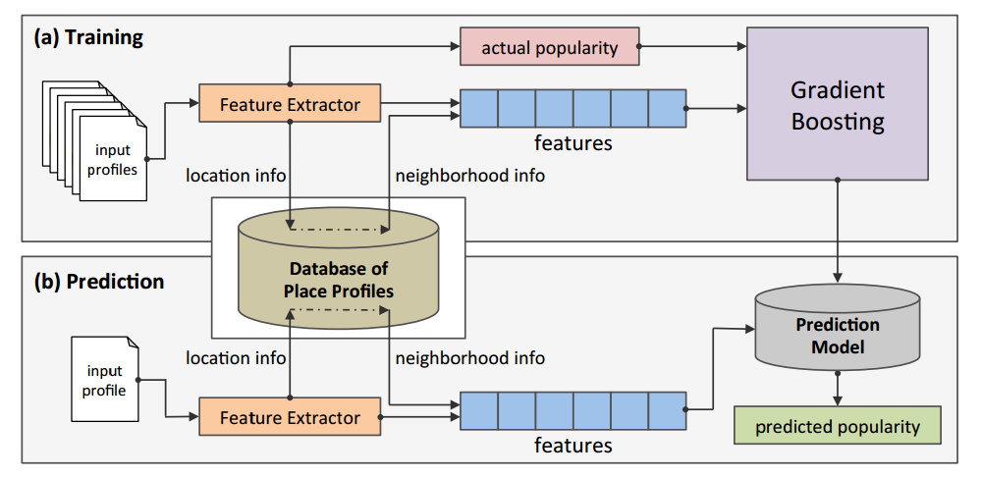
FRAMEWORK

Slide 7
FUTURE WORK
Increase the size of the database to include data about as many places as possible to improve the accuracy of the model.
Check among different machine learning algorithms to be used in the prediction model to select the algorithm that provides the highest accuracy.
Identify the different factors that affect the popularity of a physical retail stores and perform sensitivity analysis on the identified parameters.

Slide 8
Thank You!

